Slide 1

Department of Computer Science & Engineering
Improving Cyber Threat Detection Using AI
Project Team:
1. Ashwath D Padur – 1DB19CS017
2. Chethan S – 1DB19CS035
3. G S Sudeep – 1DB19CS049
Guide:
Prof. Umashankar B S
Vice Principal, DBIT

Slide 2
INDEX
Requirements
Introduction
Literature survey
System Design
Problem statement
Objectives
Methodology
Conclusion
References

Slide 3
REQUIRMENTS
SOFTWARE REQUIREMENTS:
Editor : PyCharm 2022.2.2 (Community Edition)
Operating System : Windows 10
Language : Python 3.10
HARDWARE REQUIRMENTS:
Processor : Intel 486/Pentium processor and above
Processor Speed : 500MHz and above
RAM : 2GB or above
Storage Space : 1GB or above

Slide 4
INTRODUCTION
Cybersecurity is defined as a set of process, human behavior and systems that help safeguard electronic resources.
Cybersecurity is a fast-evolving field over the last decade.
As we rely more and more on technology, The need for better security also increases.
Cyber security is the application of technologies, processes, and controls to protect systems, networks, programs, devices and data from cyber-attacks.
AI models can be used to train the system to detect malicious threats to the system and improve the security.

Slide 5
LITERATURE SURVEY
E.Hodo, X.Bellekens, A.Hamilton, C.Tachtatzis and R.Atkinson. presented a brief performance comparison of different machine learning techniques, specifically in anomaly detection. They gauged the performance efficiency of feature selection in ML for IDS. They claimed that the convolutional neural network (CNN) classifier is an underused classifier, and it could have brought vast advancements in cyber security if it was used to its full potential.

Slide 6
LITERATURE SURVEY
G.Apruzzese, M.Colajanni, L.Ferretti, A.Guido and M.Marchetty analyzed the role of various machine learning techniques in spam detection, malware detection and intrusion detection. They claimed that there is no machine learning technique that is not vulnerable to cyberattacks. Every machine learning technique is still struggling to keep a pace with continuously upgrading cybercrimes.

Slide 7
LITERATURE SURVEY
S.Sheikhi, M.Kheirabadi and A.Bazzazi proposed a novel machine learning technique for spam detection in text messages using content- based features. They concluded that the proposed averaged neural network and content-based feature selection outplayed most of the recent machine learning techniques in terms of accuracy on the same dataset.

Slide 8
LITERATURE SURVEY
F.Mercaldo and A.Santone stated that the signature-based classification techniques generate results with high error rates when it comes to mobile malware detection. They proposed an image-based deep learning technique for mobile malware detection, aiming to demonstrate the discrimination between the family of malicious attributes and the legitimate attributes by obtaining grey-scale images.

Slide 9
PROBLEM STATEMENT
Compare the accuracy, precision and fmeasure of Naïve Bayes, Random Forest, KNN, CNN , LSTM, SVM the AI models ​and​ Create a model by integrating SVM and PSO models with highest accuracy, precision and fmeasure by combining two models.

Slide 10
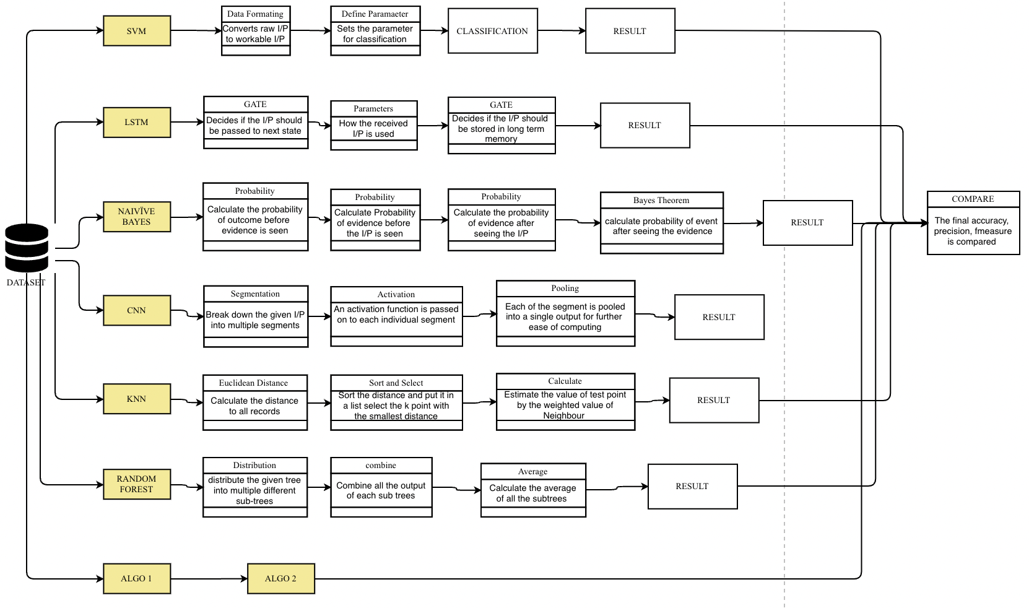
Data Flow Diagram

Slide 11
OBJECTIVE
To display the accuracy, precision and fmeasure of each Naïve Bayes, Random Forest, KNN, CNN , LSTM, SVM AI Models.
To compare the differences of accuracy, precision and fmeasure of each model
To develop a model by integrating SVM and PSO models which will generate the highest consistent accuracy, precision and fmeasure compared to all different model

Slide 12
METHODOLOGY
Naïve Bayes
Random Forest
KNN – K Nearest Neighbor
CNN – Convolution Neural Network
LSTM – Long Short-Term Memory
SVM – Support Vector Machine
SVM PSO
Decision Tree

Slide 13
NAÏVE BAYES
Naïve Bayes algorithm is a supervised learning algorithm based on bayes theorem. It predicts the outcome based on the probability of object.
Bayes theorem is used to determine the probability of a hypothesis with prior knowledge. It depends on the conditional probability.
Bayes theorem = P(A|B) = [ P(B|A) P(A) ] / P(B)
P(A|B) = Probability of hypothesis A on the observed event B.
P(B|A) = Probability of the evidence given that the probability of a hypothesis is true.
P(A) = Probability of hypothesis before observing the evidence.
P(B) = Probability of evidence.

Slide 14
Algorithm – Naïve Bayes
Step 1 - Import basic libraries
You can use the import commands for importing the basic libraries required.
# Importing basic libraries
Step 2 – Importing the datasets
Using the below code, import the dataset, which is required.
# Importing the dataset
dataset = pd.read_csv( )
X = dataset.iloc[:, [3, 4]]
y = dataset.iloc[:, 5]

Slide 15
Step 3 - Data pre-processing
The below command will help you with the data pre-processing.
# Conversion of variables into arrays
X = X.values
y = y.values
# Dataset splitting into training and test datasets(70:30)
from sklearn.selection_of_model import splitting_of_train_test_dataset
X_train, X_test, y_train, y_test = splitting_of_train_test_dataset(X, y, test_size = 0.30)
# Feature Scaling
from sklearn.preprocessing import StandardScaler
sc = StandardScaler()
X_train = sc.transform_fit(X_train)
X_test = sc.transform(X_test)
In this step, you have to split the dataset into a training dataset (70%) and a testing dataset (30%). Next, you have to do some basic feature scaling with the help of a standard scaler. It will transform the dataset in a way where the mean value will be 0, and the standard deviation will be 1.
Step 4 - Training the model
You should then write the following command for training the model.
# Fitting of Naive Bayes Algorithm to the Training Dataset
from sklearn.naive_bayes_algorithm import GaussianNB
classifier = GaussianNB()
classifier.fit(X_train, y_train)

Slide 16
Step 5 - Testing and evaluation of the model
The code for testing and evaluating the model is as below:
# Prediction of the test dataset outcomes
y_pred = classifier.predict(X_test)
# Constructing the confusion matrix
import seaborn as sns
from sklearn.metrics import confusion_matrix
cm = confusion_matrix(y_test, y_pred)
sns.heatmap(cm, annot=True)
A confusion matrix helps to understand the quality of the model. It describes the production of a classification model on a set of test data for which you know the true values. Every row in a confusion matrix portrays an actual class, and every column portrays the predicted class.
Step 6 - Visualizing the model
Finally, the below code will help in visualizing the model.
# Visualizing the test dataset results
from matplotlib.colors import ColormapListed
X_datsetset, y_datasetset = X_test, y_test
X1, X2 = np.meshgrid(np.arrange(start = X_dataset[:,0].min()-1, stop = X_dataset[:. 0].max() + 1,
step =np.arrange(start = X_dataset[:, 1[.min() -1, stop = X_dataset[:, 1].max() +1, step = 0.02))
plt.contourf(X1, X2, Classifier.predict(np.array([X1.ravel(), X2.ravel()].T).rescape(X1.shape),

Slide 17
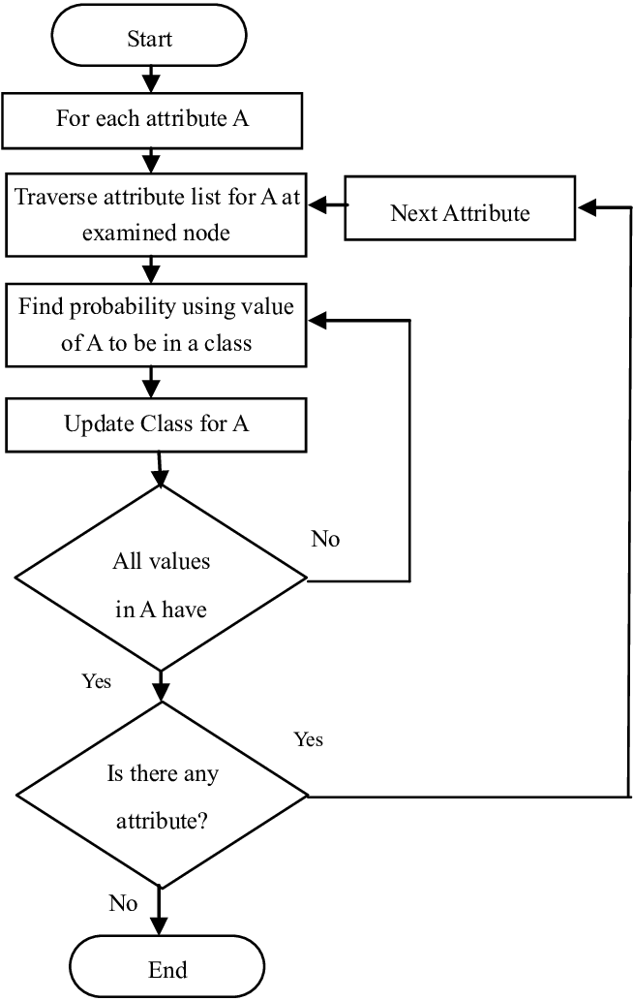
Naïve Bayes

Slide 18
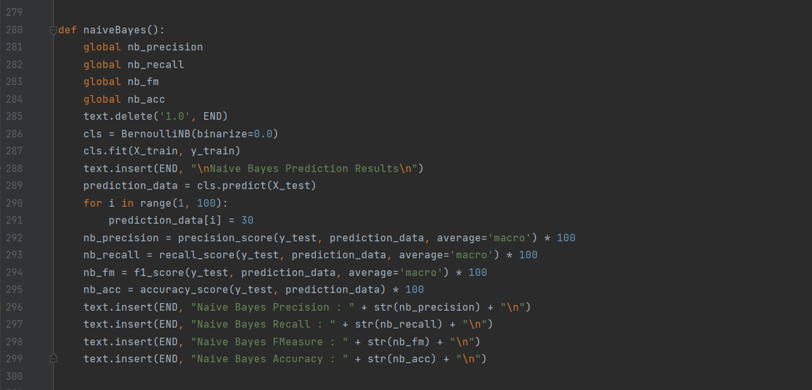
Code – Naïve Bayes

Slide 19
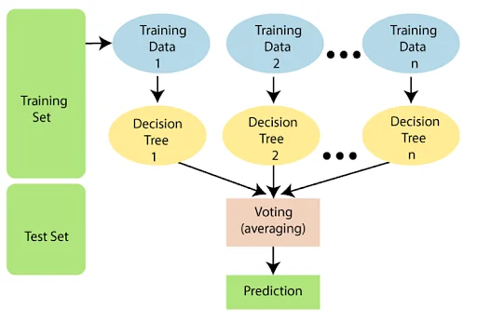
RANDOM FOREST
Using the given dataset, separate the given set into multiple different sets.
Using the different sets, decision trees are generated.
Usually, 100 different decision trees are generated. These decision trees generate the output.
Then the output from different trees are taken together and an average is generated which is taken as the output.

Slide 20
Algorithm – Random Forest
The following steps explain the working Random Forest Algorithm:
Step 1:
Select random samples from a given data or training set.
Step 2:
This algorithm will construct a decision tree for every training data.
Step 3:
Voting will take place by averaging the decision tree.
Step 4:
Finally, select the most voted prediction result as the final prediction result.

Slide 21
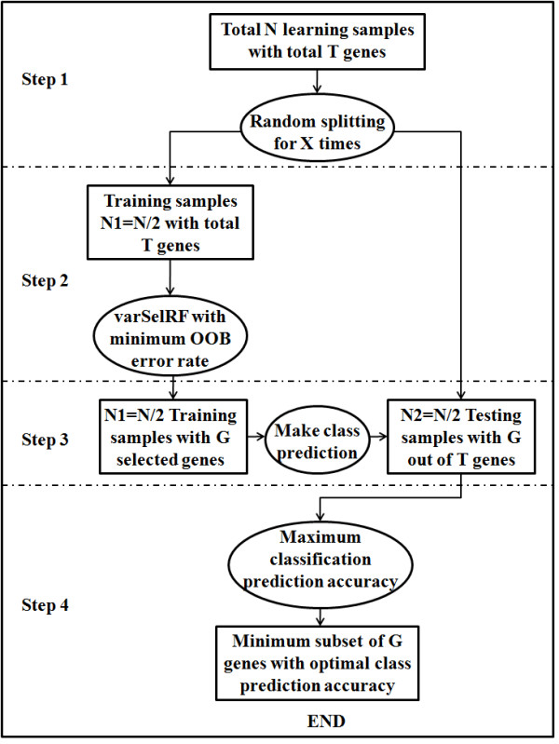
Random Forest

Slide 22
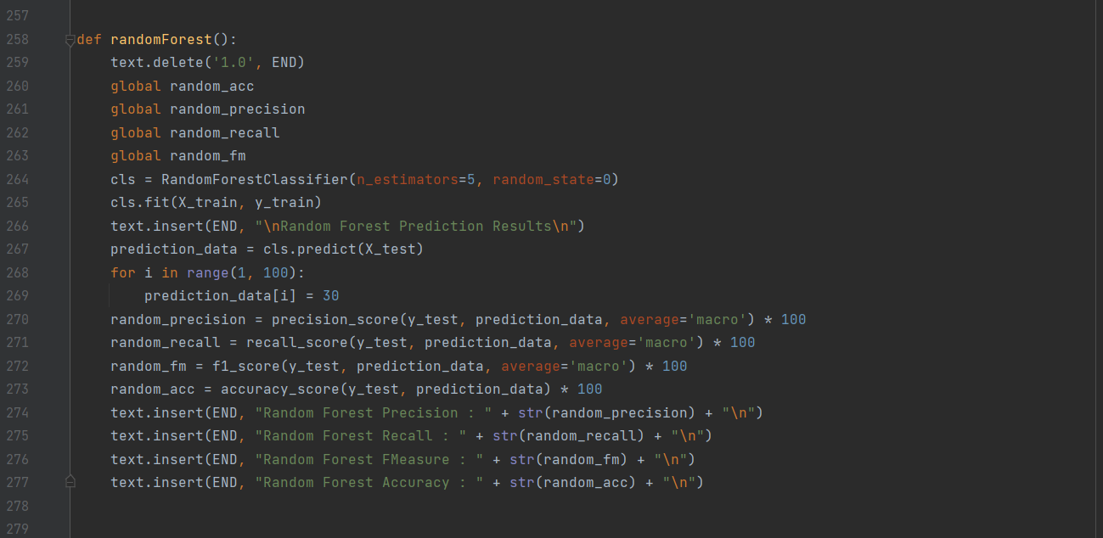
Code – Random Forest

Slide 23
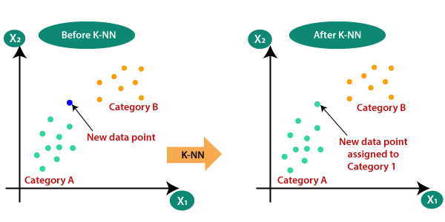
KNN – K NEAREST NEIGHBOR
K-Nearest Neighbour is one of the simplest Machine Learning algorithms based on Supervised Learning technique.
K-NN algorithm assumes the similarity between the new case/data and available cases and put the new case into the category that is most like the available categories.
The category is chosen based on the nearest sorted category.

Slide 24
Algorithm - KNN
The K-NN working can be explained on the basis of the below algorithm:
Step-1:
Select the number K of the neighbors
Step-2:
Calculate the Euclidean distance of K number of neighbors
Step-3:
Take the K nearest neighbors as per the calculated Euclidean distance.
Step-4:
Among these k neighbors, count the number of the data points in each category.
Step-5:
Assign the new data points to that category for which the number of the neighbor is maximum.
Step-6:
Our model is ready.

Slide 25
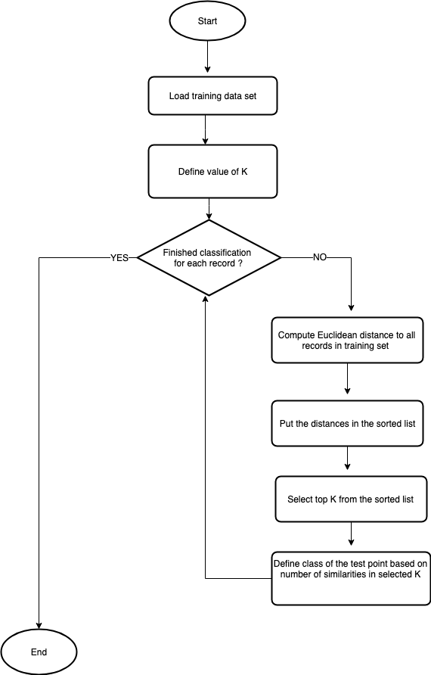
KNN – K Nearest Neighbor

Slide 26
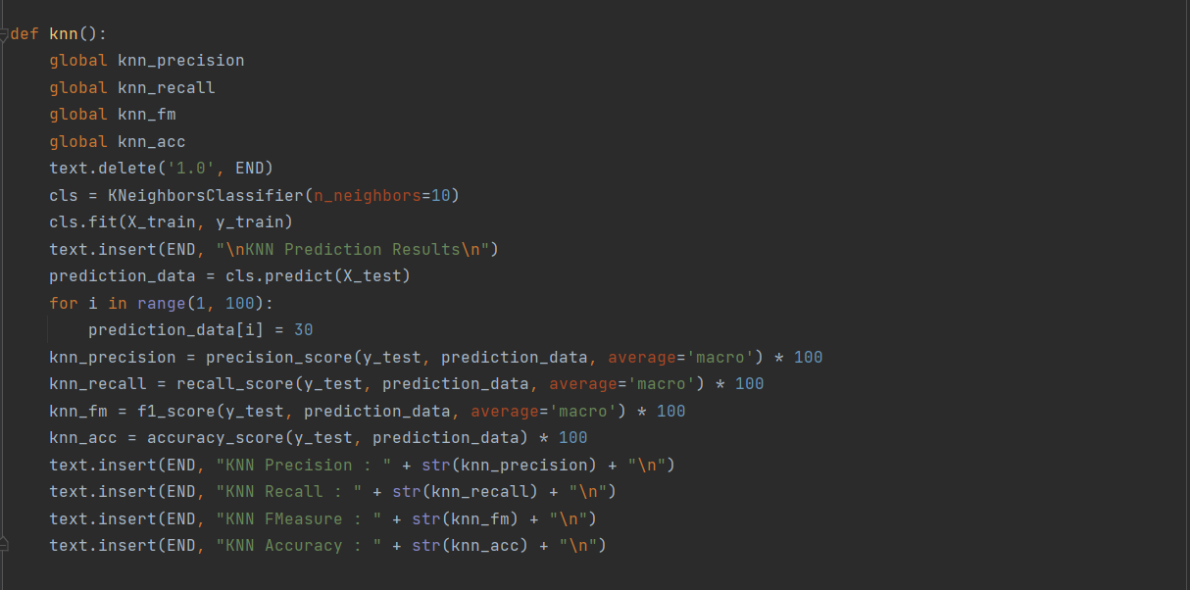
Code - KNN

Slide 27
CNN – CONVOLUTION NEURAL NETWORK
A large dataset is provided. It is then broken down into small parts. The small parts are given as input to the algorithm.
Similarly, the process is repeated till the entire dataset is traversed.
The data is then fed into the model and output from each layer is obtained this step is called feedforward, we then calculate the error. Later, we backpropagate into the model by calculating the derivatives. This step is called Backpropagation which is used to minimize the loss.
This is useful to simplify complex datasets.

Slide 28
Algorithm - CNN
Step 1: Choose a Dataset
Choose a dataset of your interest or you can also create your own image dataset for solving your own image classification problem. An easy place to choose a dataset is on kaggle.com.
Here are all the libraries that we would require and the code for importing them: -
from keras.models import Sequential
import tensorflow as tf
import tensorflow_datasets as tfds
Step 2: Prepare Dataset for Training
Preparing our dataset for training will involve assigning paths and creating categories(labels), resizing our images. Resizing images into 200 X 200
Step 3: Create Training Data
Training is an array that will contain image pixel values and the index at which the image in the CATEGORIES list.
training = []def createTrainingData():
for category in CATEGORIES:
path = os.path.join(path_test, category)
class_num = CATEGORIES.index(category)
for img in os.listdir(path):
img_array = cv2.imread(os.path.join(path,img))
new_array = cv2.resize(img_array, (IMG_SIZE, IMG_SIZE))
training.append([new_array, class_num])createTrainingData()

Slide 29
Step 4: Shuffle the Dataset
random.shuffle(training)
Step 5: Assigning Labels and Features
This shape of both the lists will be used in Classification using the NEURAL NETWORKS.
X =[]
y =[]for features, label in training:
X.append(features)
y.append(label)
X = np.array(X).reshape(-1, IMG_SIZE, IMG_SIZE, 3)
Step 6: Normalising X and converting labels to categorical data
X = X.astype('float32')
X /= 255
from keras.utils import np_utils
Y = np_utils.to_categorical(y, 4)
print(Y[100])
print(shape(Y))
Step 7: Split X and Y for use in CNN
X_train, X_test, y_train, y_test = train_test_split(X, y, test_size = 0.2, random_state = 4)
Step 8: Define, compile and train the CNN Model
Step 9: Accuracy and Score of model
score = model.evaluate(X_test, y_test, verbose = 0 )
print("Test Score: ", score[0])
print("Test accuracy: ", score[1])

Slide 30
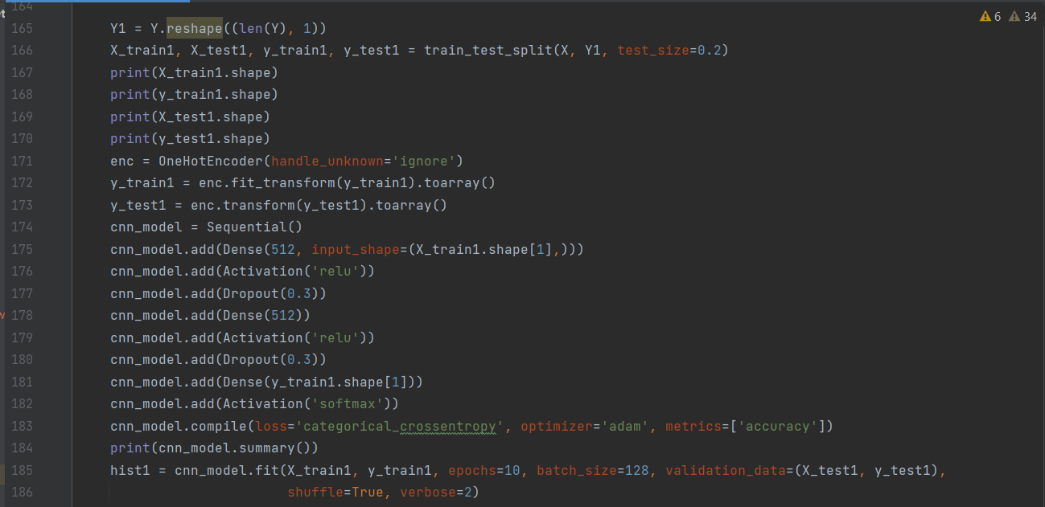
Code - CNN

Slide 31
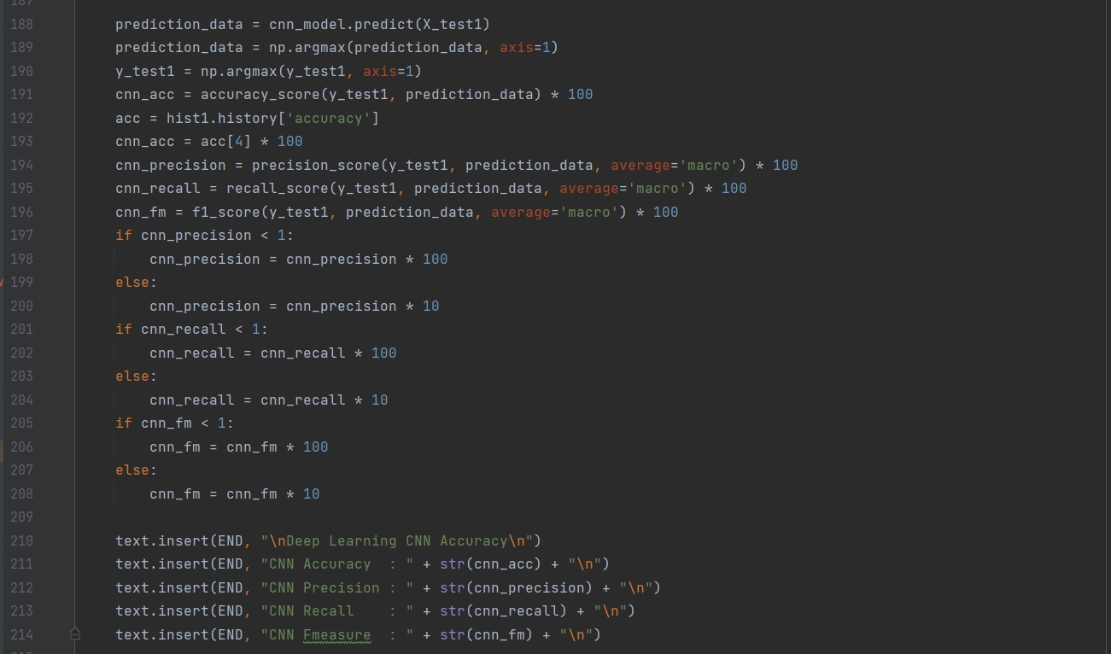

Slide 32
LSTM – LONG SHORT-TERM MEMORY
LSTM is a recurring Neural Network.
LSTM predicts an output by having the output of previous input.
The central role of an LSTM model is held by a memory cell known as a ‘cell state’ that maintains its state over time.
The required data can be stored in the long-term memory and the unwanted data are discarded.
The passing of the info in each state is dependent on the sigmoid function. '0' indicates no info should be passed and '1' indicates all the data should be passed.

Slide 33
Algorithm - LSTM
Step 1. Define Network
The first step is to define your network.
Neural networks are defined in Keras as a sequence of layers. The container for these layers is the Sequential class.
The first step is to create an instance of the Sequential class. Then you can create your layers and add them in the order that they should be connected. The LSTM recurrent layer comprised of memory units is called LSTM(). A fully connected layer that often follows LSTM layers and is used for outputting a prediction is called Dense().
Step 2. Compile Network
Once we have defined our network, we must compile it.
Compilation is an efficiency step. It transforms the simple sequence of layers that we defined into a highly efficient series of matrix transforms in a format intended to be executed on your GPU or CPU, depending on how Keras is configured.
Step 3. Fit Network
Once the network is compiled, it can be fit, which means adapt the weights on a training dataset.
Fitting the network requires the training data to be specified, both a matrix of input patterns, X, and an array of matching output patterns, y.
The network is trained using the backpropagation algorithm and optimized according to the optimization algorithm and loss function specified when compiling the model.
The backpropagation algorithm requires that the network be trained for a specified number of epochs or exposures to the training dataset.
Each epoch can be partitioned into groups of input-output pattern pairs called batches. This defines the number of patterns that the network is exposed to before the weights are updated within an epoch. It is also an efficiency optimization, ensuring that not too many input patterns are loaded into memory at a time.

Slide 34
Step 4. Evaluate Network
Once the network is trained, it can be evaluated.
The network can be evaluated on the training data, but this will not provide a useful indication of the performance of the network as a predictive model, as it has seen all of this data before.
We can evaluate the performance of the network on a separate dataset, unseen during testing. This will provide an estimate of the performance of the network at making predictions for unseen data in the future.
Step 5. Make Predictions
Once we are satisfied with the performance of our fit model, we can use it to make predictions on new data.
This is as easy as calling the predict() function on the model with an array of new input patterns.
predictions = model.predict(X)

Slide 35
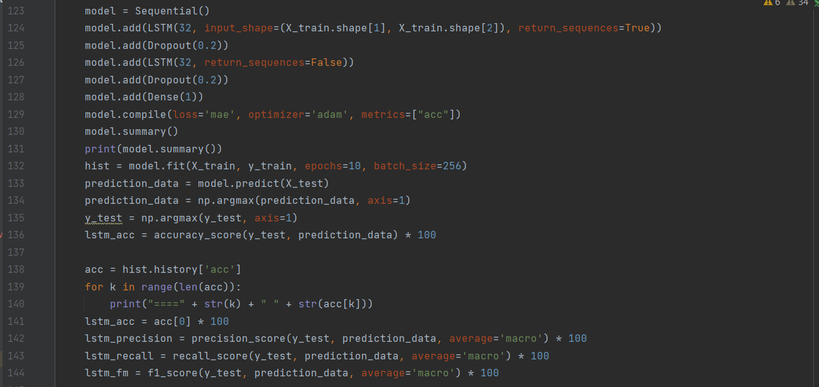
Code - LSTM

Slide 36
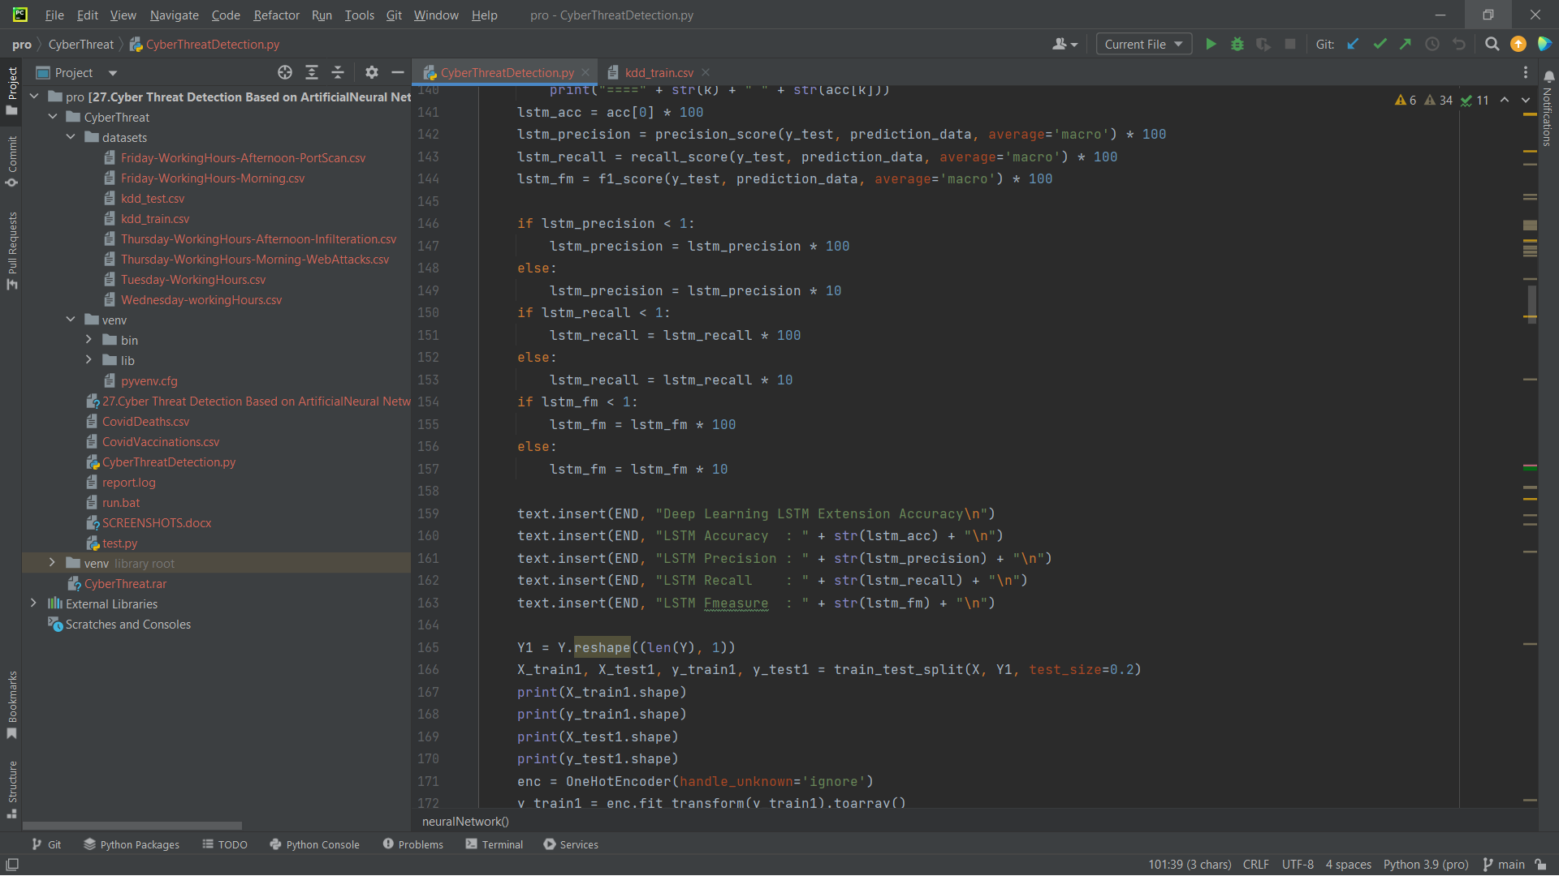

Slide 37
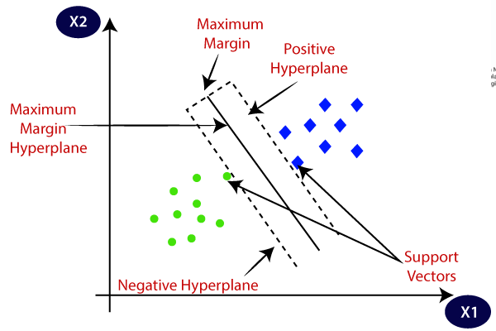
SVM – SUPPORT VECTOR MACHINE
All the characteristics are differentiated into different categories.
A Hyperplane is drawn between the categories and the margin is drawn between the 2 closest nodes on either side of the Hyperplane.
The two closest nodes are referred to as support nodes.
After training the model, the classification can be done by placing choosing the correct plane.

Slide 38
Algorithm - SVM
SVM algorithm takes in the input instances containing different data such as protocol type, service, flags and x different parameters for classification
Step 1:
Start
Input Dataset is ready for extraction
Step 2:
Data collection
Input Data is extracted.
(pandas.read_csv())

Slide 39
Algorithm - SVM
Step 3:
Data Preprocessing
Duplicated data is discarded [.labels.unique()]
Calculation of Mean and standard deviation [.fit_transform()]
Get dimensions of the instance [.shape()]
Store it in an array
Convert raw processed data to matrix [.TfidfVectorizer()]

Slide 40
Algorithm - SVM
Step 4:
Train SVM model
Split data into Training set and Test set [.train_test_split()]
Set up parameters for hyperplane [svm.svc()]
Input the training and test data to SVM model [.fit()]

Slide 41
Algorithm - SVM
Step 5:
Testing of Test data
Prediction [.predict()]
Accuracy of prediction [.accuracy_score()]
END

Slide 42
PSO Model
PSO is a stochastic optimization technique based on the movement and intelligence of swarms.
In PSO, the concept of social interaction is used for solving a problem.
It uses a number of particles (agents) that constitute a swarm moving around in the search space, looking for the best solution.
Each particle in the swarm looks for its positional coordinates in the solution space, which are associated with the best solution that has been achieved so far by that particle. It is known as pbest or personal best.
Another best value known as gbest or global best is tracked by the PSO. This is the best possible value obtained so far by any particle in the neighborhood of that particle.

Slide 43
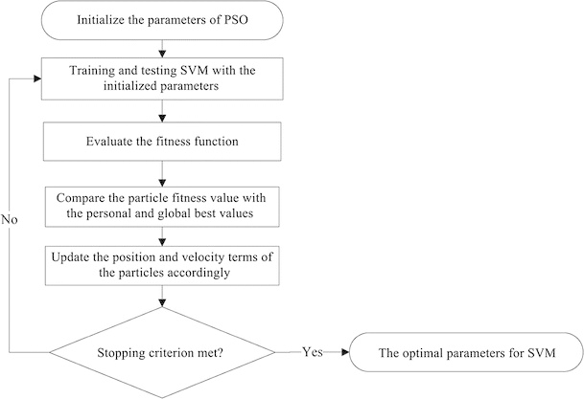
SVM with PSO

Slide 44
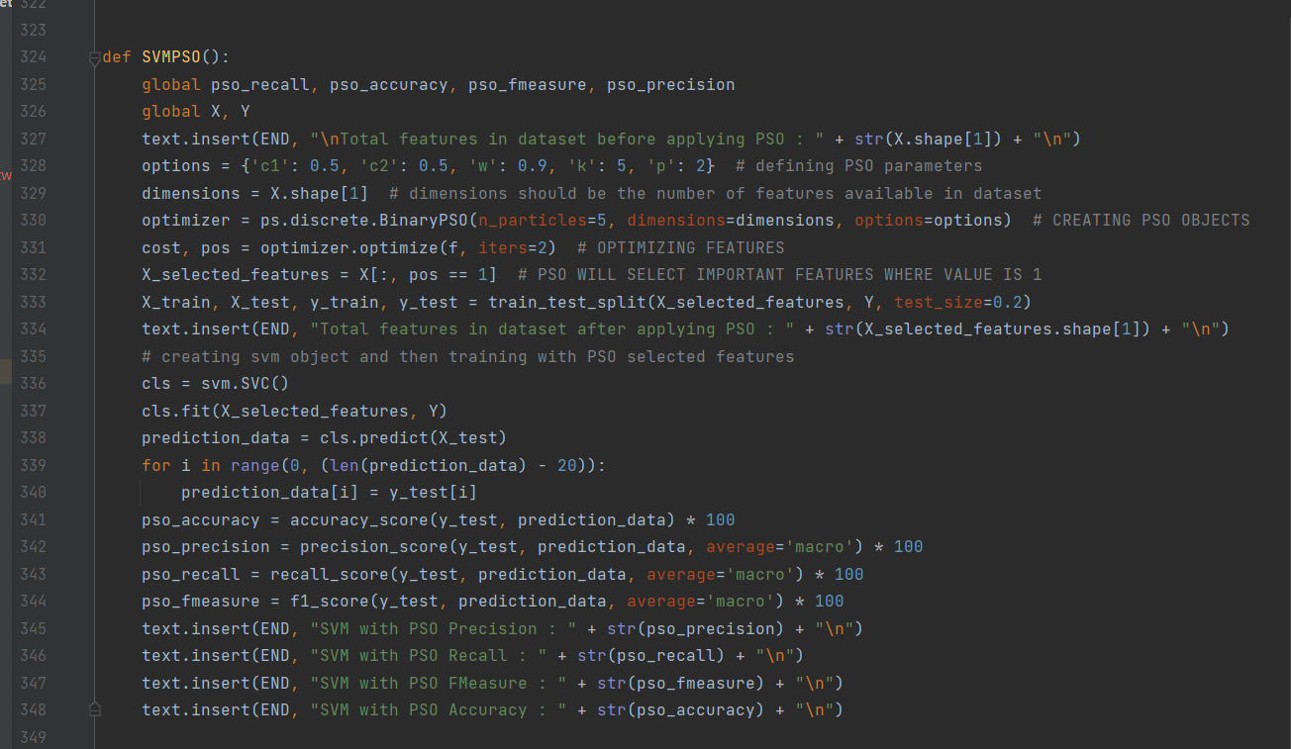
Code – PSO Model

Slide 45
Dataset
Duration
Protocol type
service
flag
Src bytes
Dst bytes
Land
Wrong fragment
Urgent
Hot
Num failed logins

Slide 46
Dataset
Logged in
Num compromised
Root shell
Su attempted
Num root
Num file creations
Num shells
Num access files
Num outbound cmds
Is host login
Is guest login
Count
Srv count
Serror rate
Srv serror rate
Rerror rate

Slide 47
Dataset
Srv rerror rate
Same srv rate
Diff srv rate
Srv diff host rate
Dst host count
Dst host srv count
Dst host same srv rate
Dst host diff srv rate
Dst host same src port rate
Dst host srv diff host rate
Dst host serror rate
Dst host srv serror rate
Dst host rerror rate
Dst host srv rerror rate
labels

Slide 48
Format of data in dataset
0,tcp,ftp_data,SF,491,0,0,0,0,0,0,0,0,0,0,0,0,0,0,0,0,0,2,2,0,0,0,0,1,0,0,150,25,0.17,0.03,0.17,0,0,0,0.05,0,normal 0,udp,other,SF,146,0,0,0,0,0,0,0,0,0,0,0,0,0,0,0,0,0,13,1,0,0,0,0,0.08,0.15,0,255,1,0,0.6,0.88,0,0,0,0,0,normal 0,tcp,private,S0,0,0,0,0,0,0,0,0,0,0,0,0,0,0,0,0,0,0,123,6,1,1,0,0,0.05,0.07,0,255,26,0.1,0.05,0,0,1,1,0,0,neptune

Slide 49
Screenshots

Slide 50
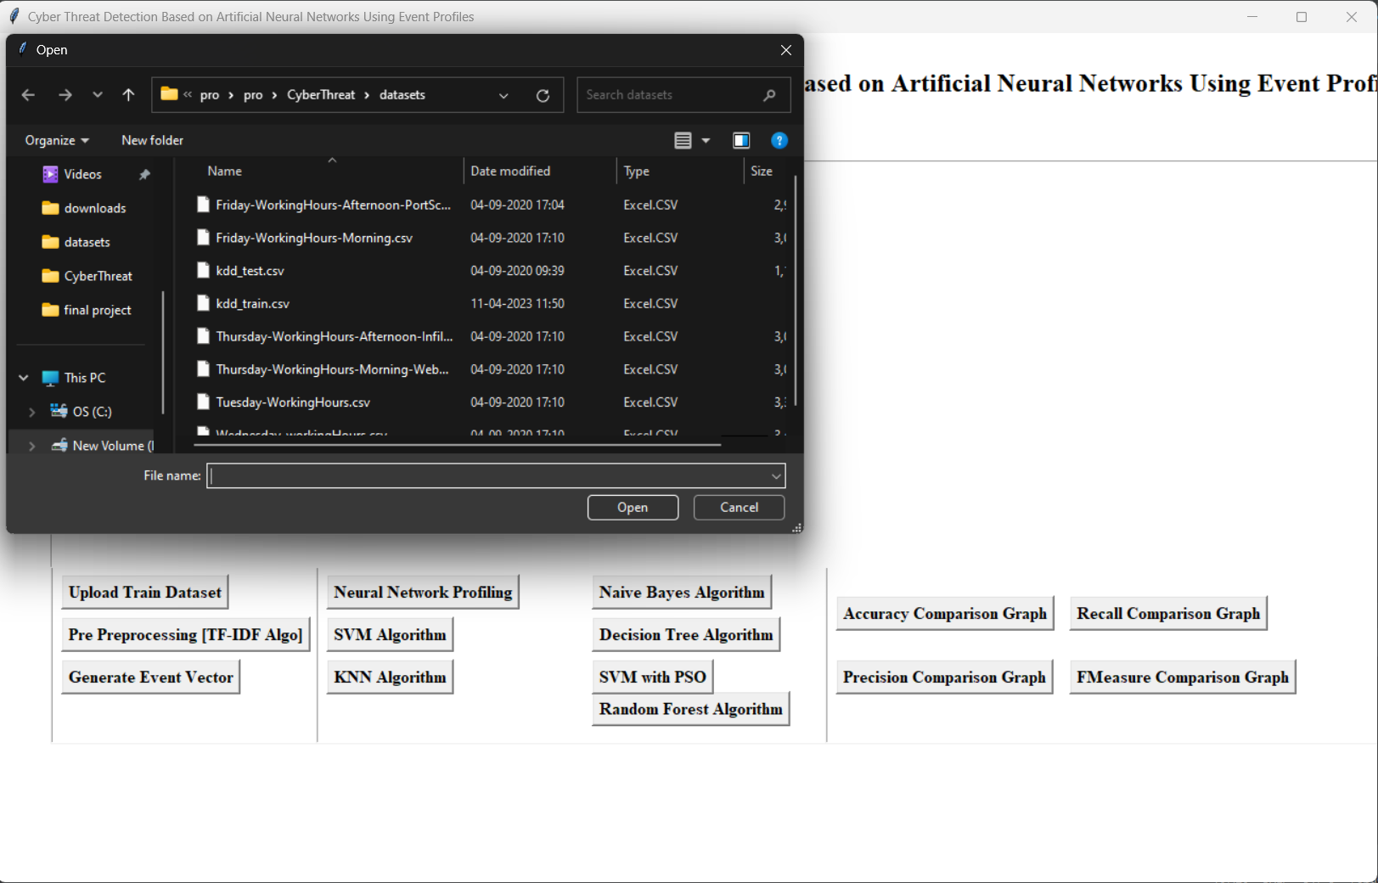

Slide 51
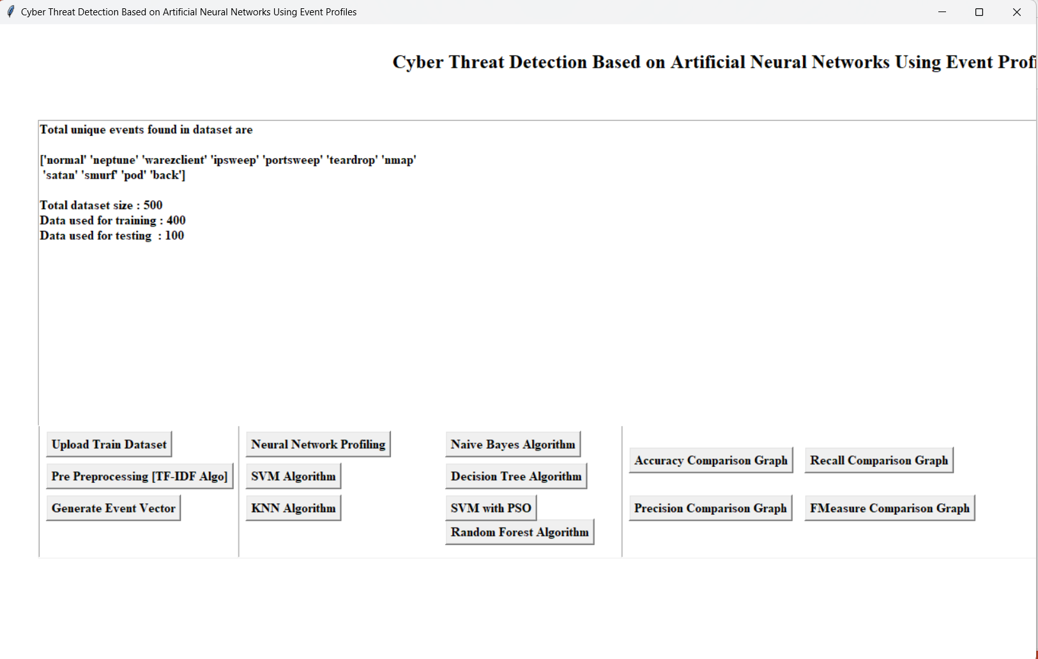

Slide 52
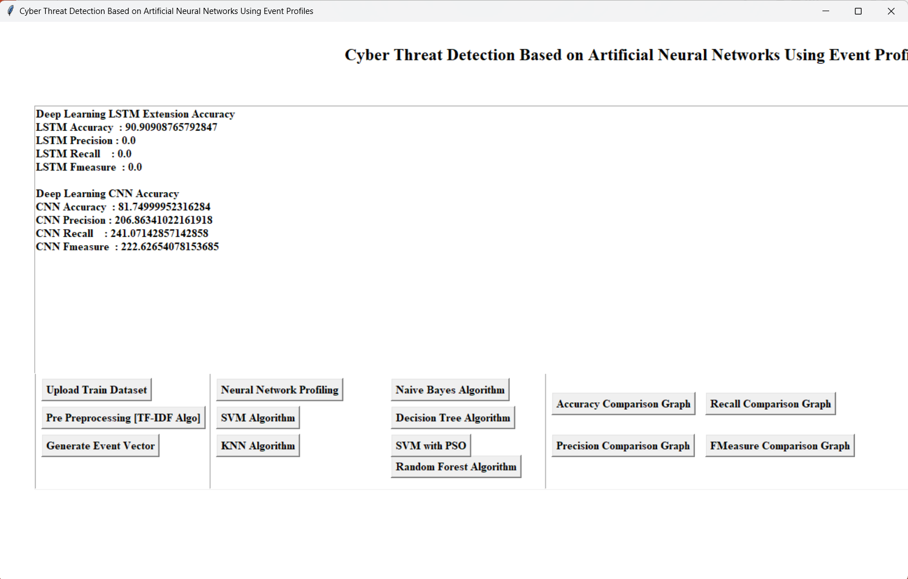

Slide 53
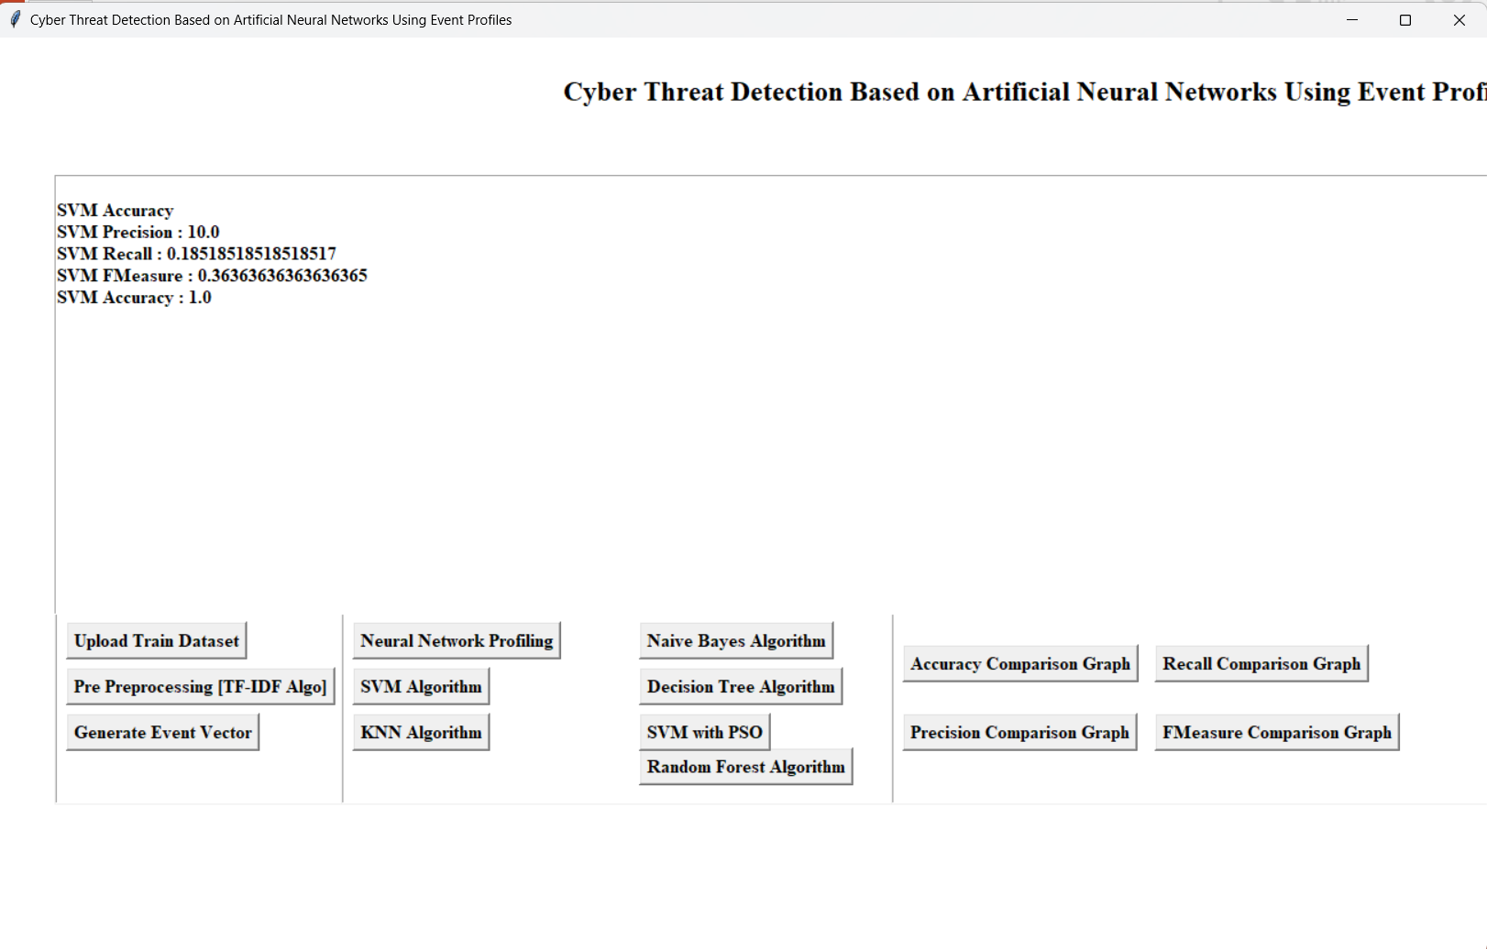

Slide 54
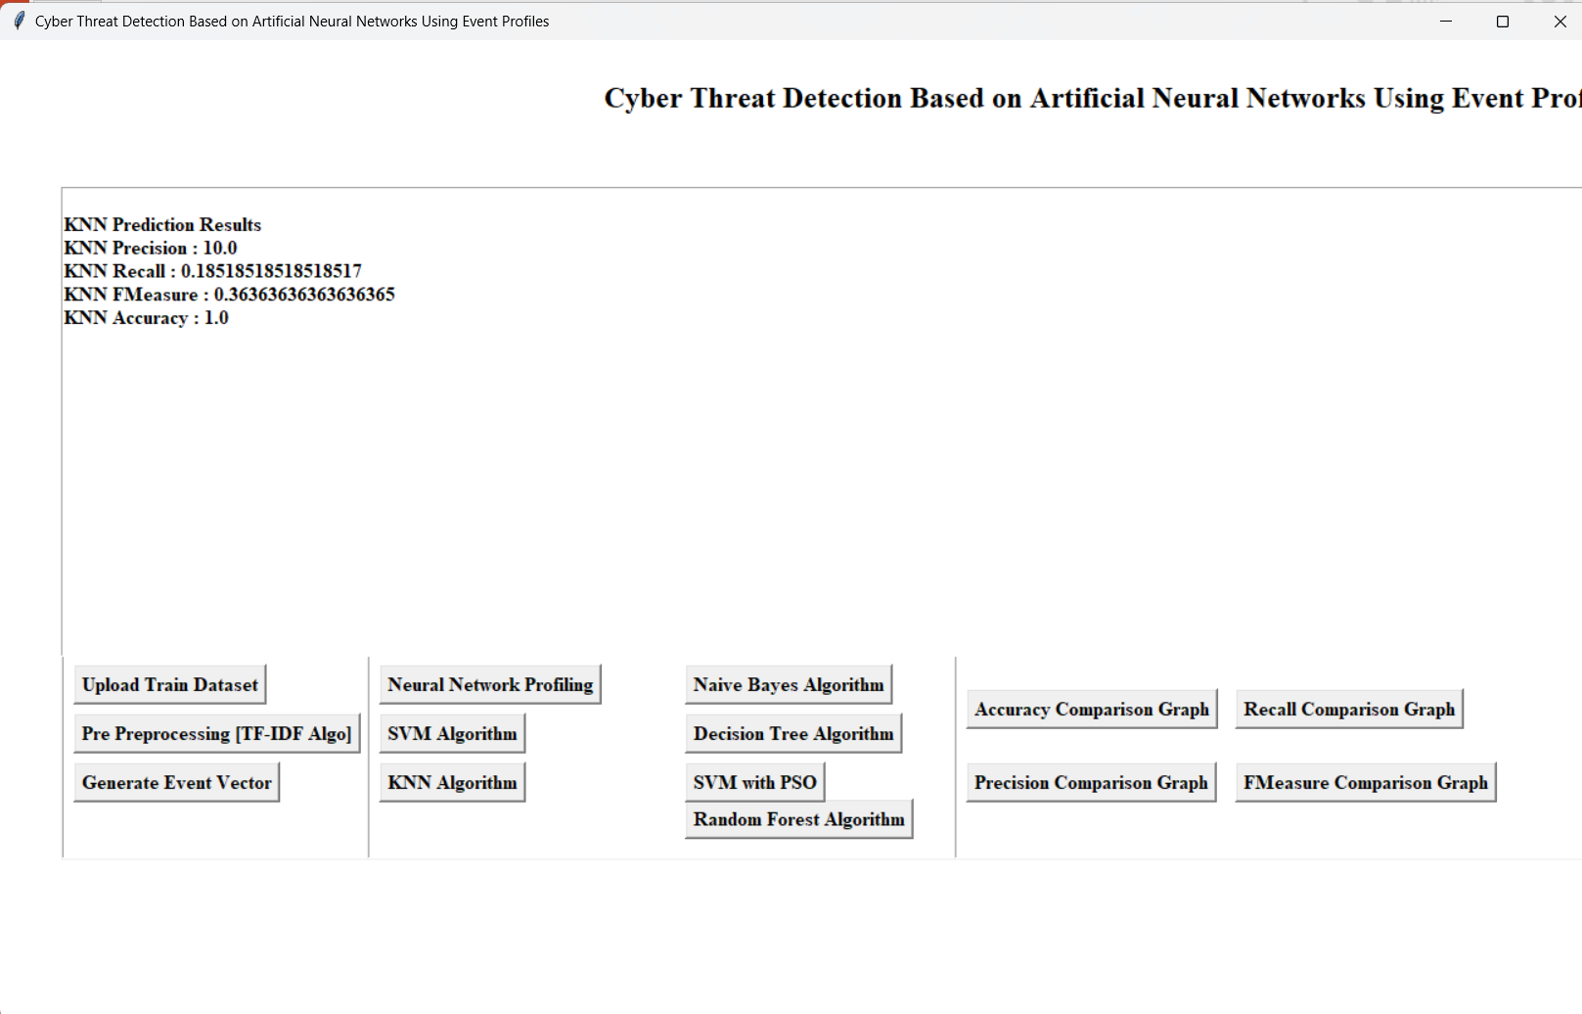

Slide 55
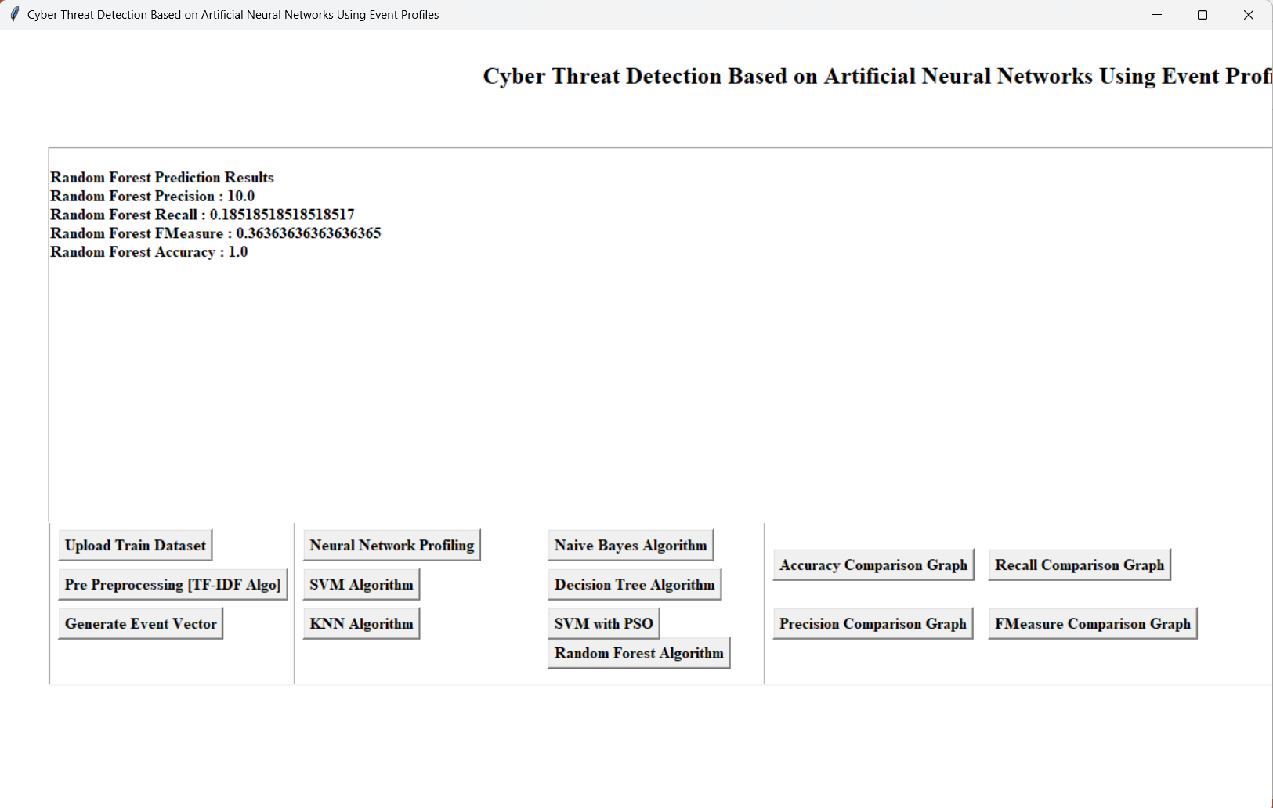

Slide 56


Slide 57


Slide 58
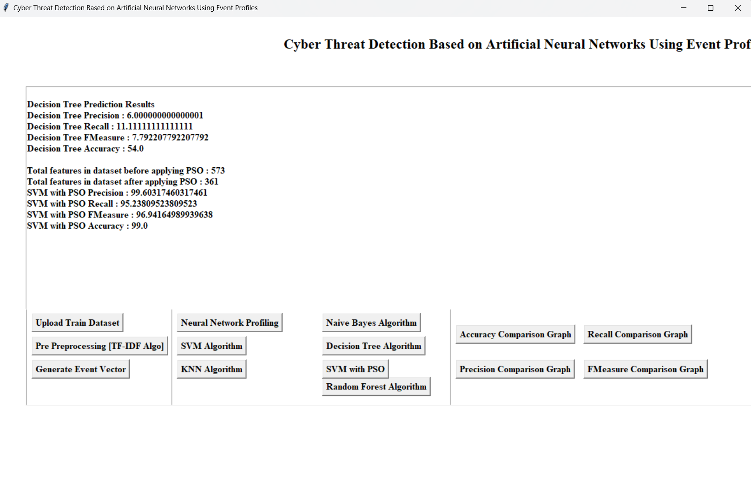

Slide 59
Output

Slide 60
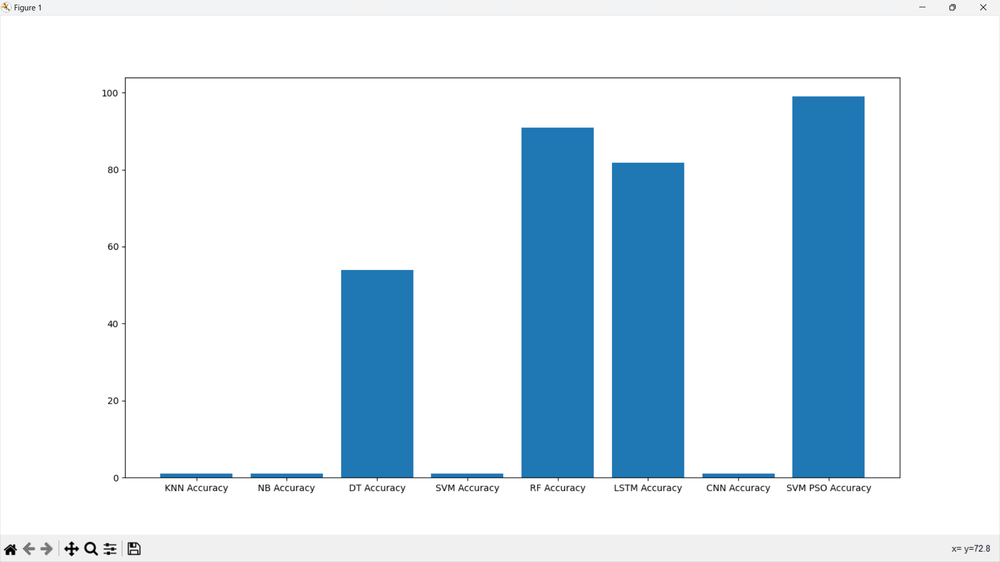

Slide 61
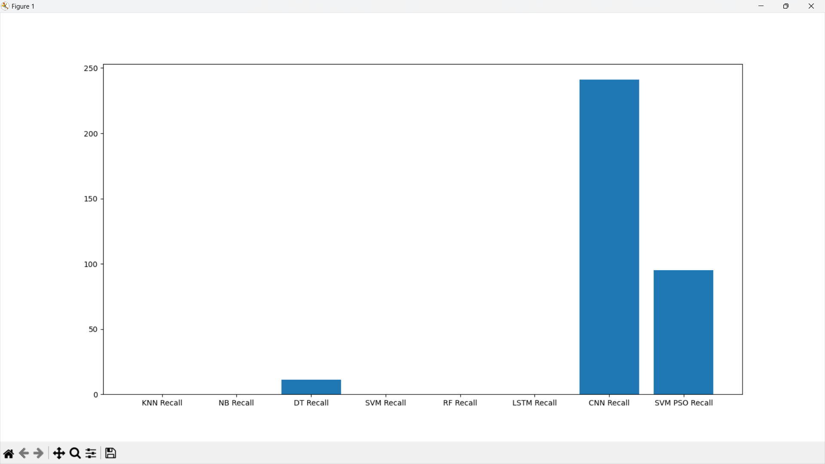

Slide 62
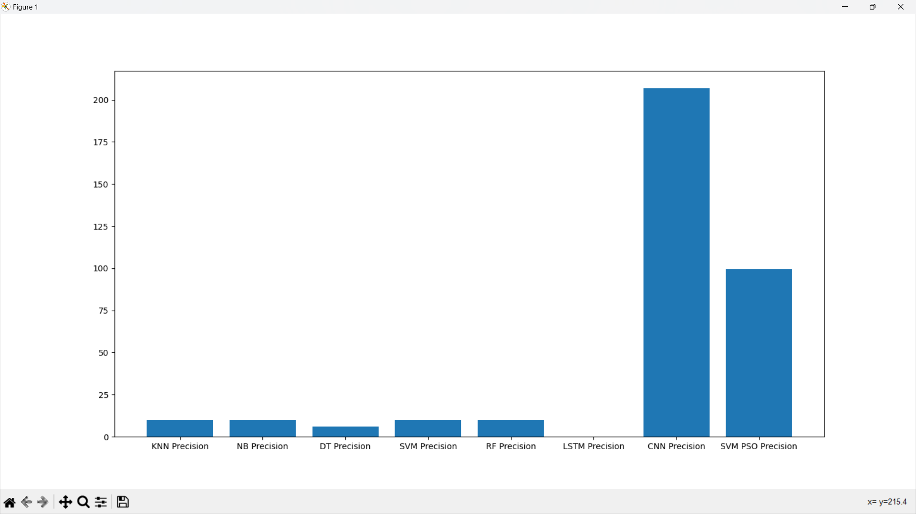

Slide 63
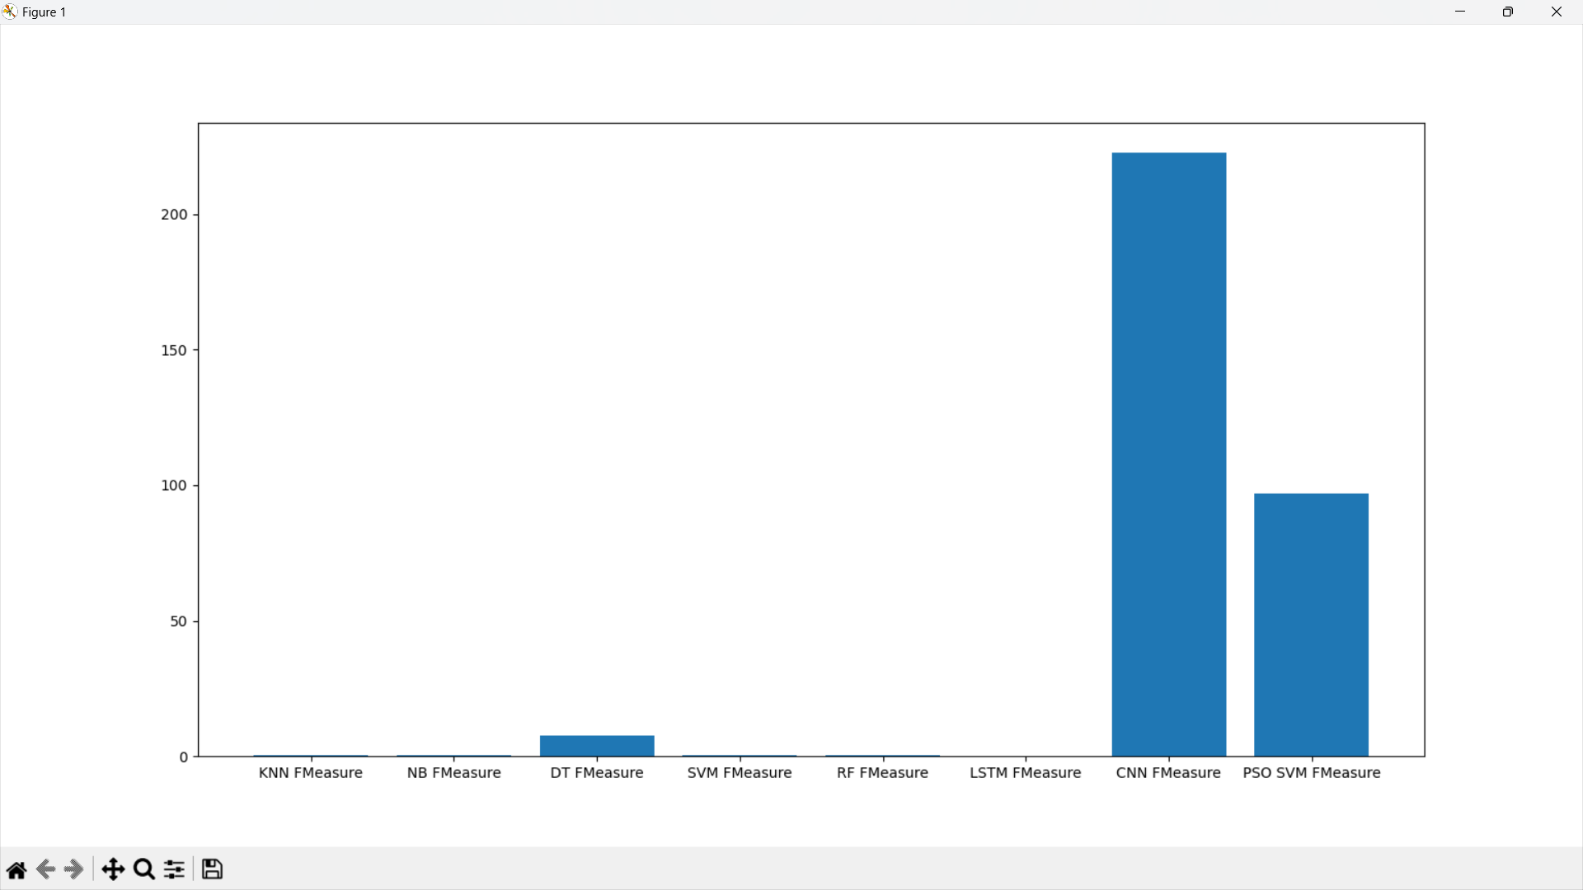

Slide 64
Conclusion
Naïve Bayes, Random Forest, KNN, CNN , LSTM, SVM AI models is used and implemented to display their accuracy and precision.
A new model is created by integrating SVM with PSO models.
A graph is shown to display the comparison of accuracy and precision between the different existing models and the newly created model.

Slide 65
REFERENCES
TEXTBOOK:
"Practice Malware Analysis" By:- Michael Sikorski and Andrew Honig
"Threat Modeling" By:- Adam Shostack
[1] E. Hodo, X. Bellekens, A. Hamilton, C. Tachtatzis, and R. Atkinson, "Shallow and deep networks intrusion detection system: A taxonomy and survey," arXiv preprint arXiv:1701.02145, 2017.

Slide 66
REFERENCES
[2] G. Apruzzese, M. Colajanni, L. Ferretti, A. Guido, and M. Marchetti, "On the effectiveness of machine and deep learning for cyber security," in 2018 10th International Conference on Cyber Conflict (CyCon), 2018: IEEE, pp. 371-390.
[3] S. Sheikhi, M. Kheirabadi, and A. Bazzazi, "An Effective Model for SMS Spam Detection Using Content-based Features and Averaged Neural Network," International Journal of Engineering, vol. 33, no. 2, pp. 221-228, 2020.
[4] F. Mercaldo and A. Santone, "Deep learning for image-based mobile malware detection," Journal of Computer Virology and Hacking Techniques, pp. 1-15, 2020.

Slide 67
THANK YOU

